Slide 1
Image Segmentation
CONVOLUTIONAL NEURAL NETWORK
IMAGE CLASSIFICATION
IMAGE SEGMENTATION
U-Net ARCHITECTURE
V-Net ARCHITECTURE

Slide 2
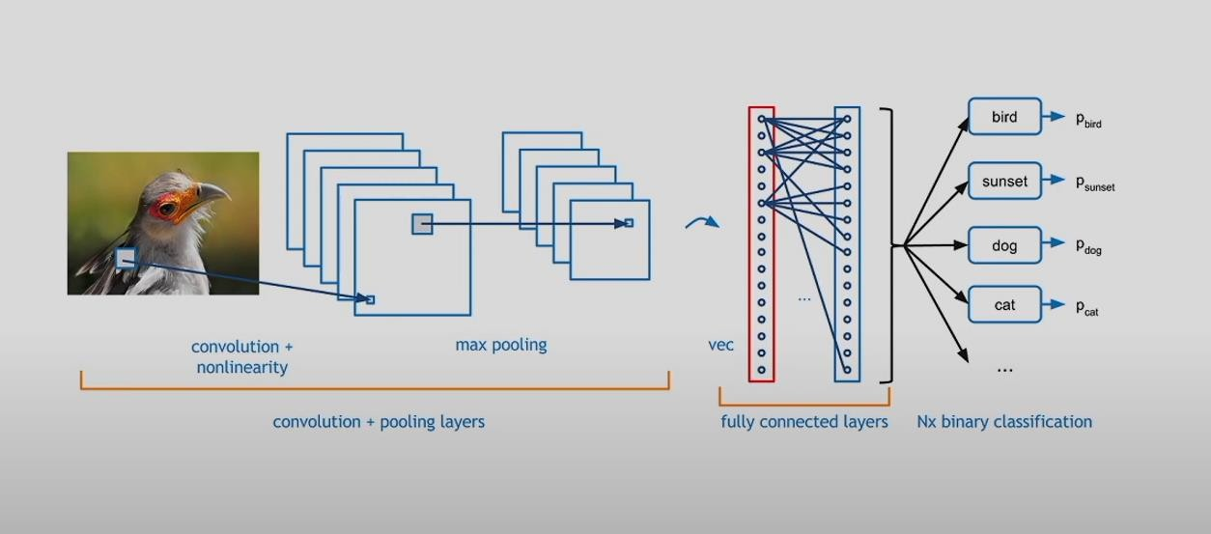
CONVOLUTIONAL NEURAL NETWORK

Slide 3
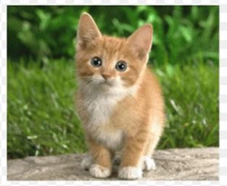
IMAGE CLASSIFICATION
56 x 56
28 x 28
28 x 28
14 x 14
14 x 14
Convolutional Unit
Down-sampling Unit
Convolutional Unit
Down-sampling Unit
Convolutional Unit
56 x 56
Cat
Fully-connected
layer
Global Average Pooling
1 x 1

Slide 4
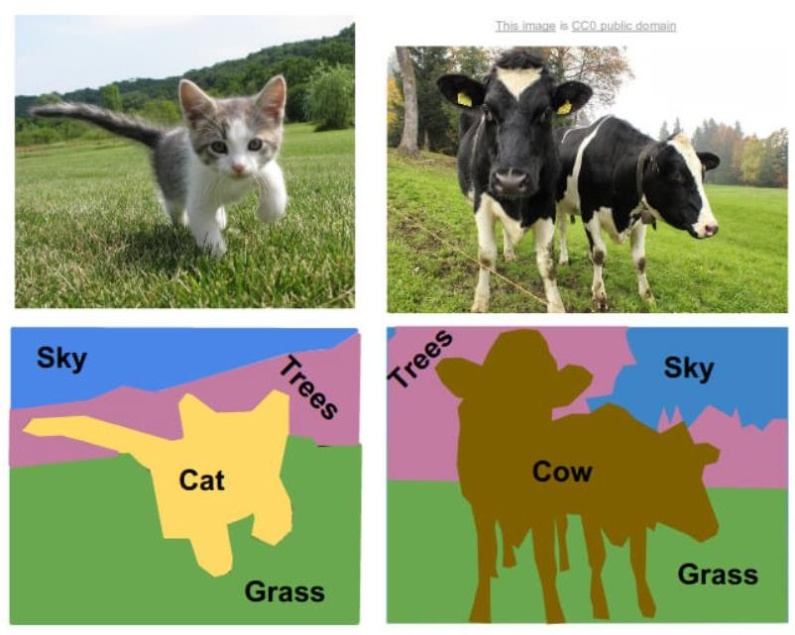
IMAGE SEGMENTATION
Pixel-wise Semantic Segmentation
Label every pixel

Slide 5

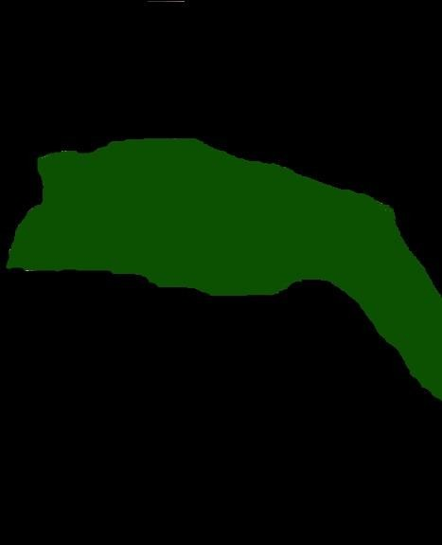
U-Net: Objective and Functionality
Learns Segmentation
U-NET
Input Image
Output Segmentation Map

Slide 6
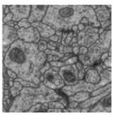
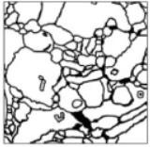
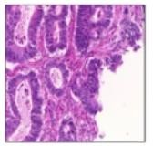
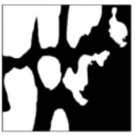
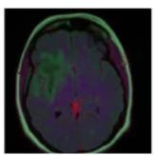
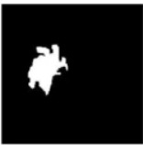
Biomedical Image Segmentation with U-Net
U-Net learns segmentation in an end-to-end setting
UNET
Ronneberger et al. (2015) U-Net Architecture
IEEE International Symposium on Biomedical Imaging (ISBI)
Input Image
Output Segmentation Map

Slide 7
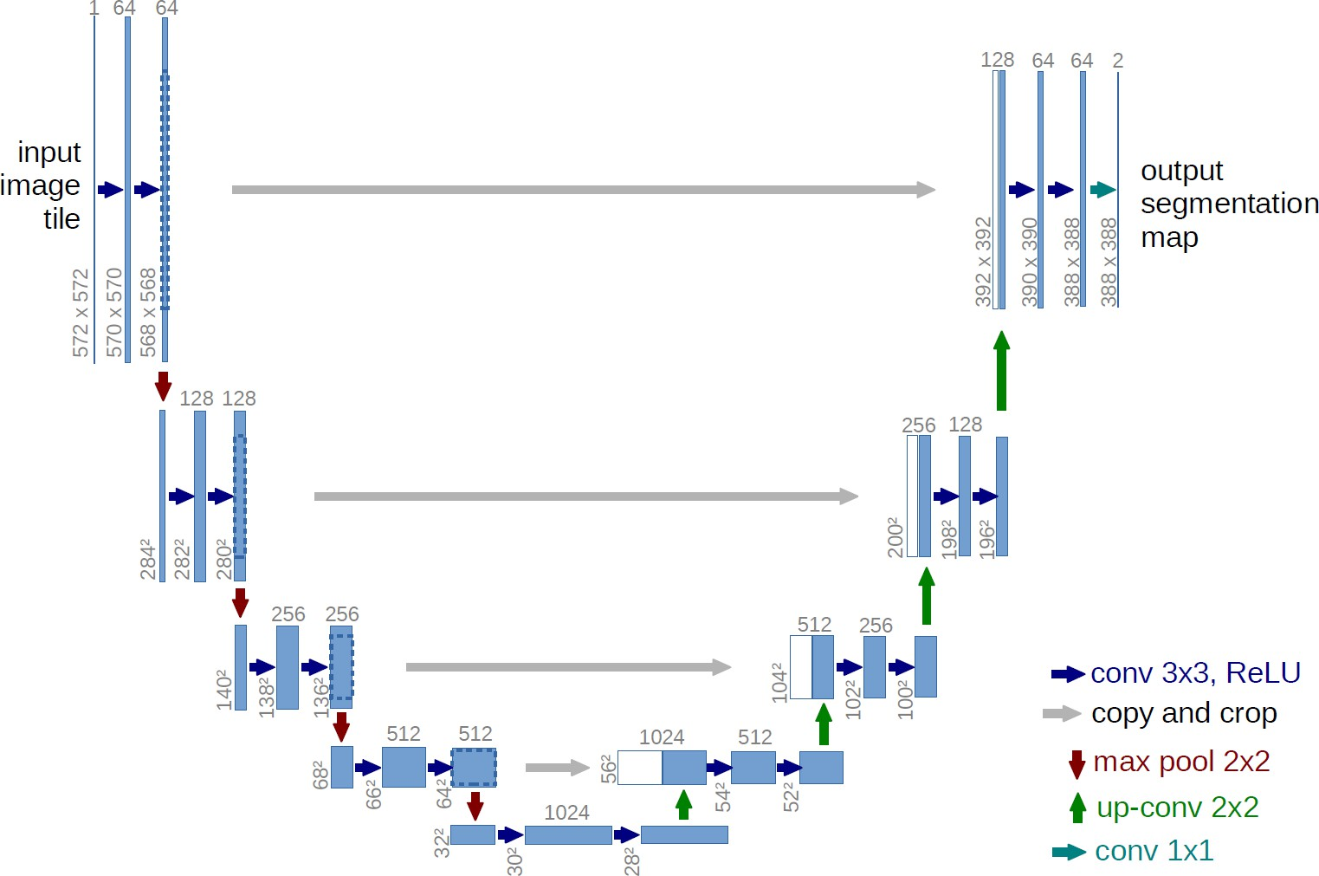
U-Net Architecture
Ronneberger et al. (2015) U-Net Architecture

Slide 8
U-Net Architecture
Contraction path
- Increases field of view
- Lose Spatial Information
Ronneberger et al. (2015) U-Net Architecture

Slide 9
U-Net Architecture
Expansion path
- Create High Resolution Mapping
Ronneberger et al. (2015) U-Net Architecture

Slide 10
U-Net Architecture
Concatenate with high- resolution feature maps from the Contraction Phase
Ronneberger et al. (2015) U-Net Architecture

Slide 11
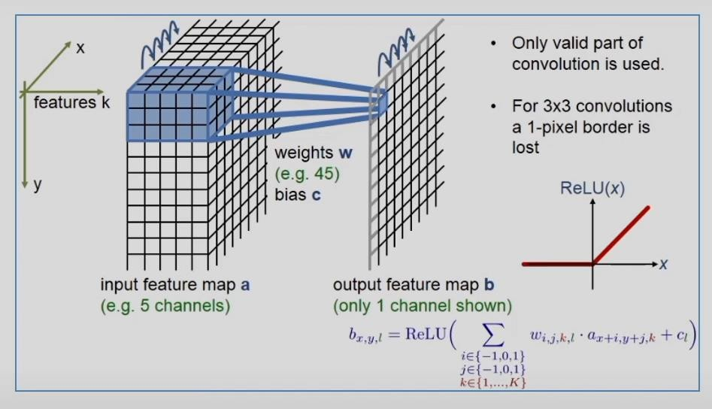
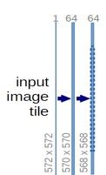

U-Net Architecture
OUTPUT SIZE
(First Conv)
= (|572 -3 + 2*0|1)+1
= 570
(570 x 570)
OUTPUT SIZE
(Second Conv)
= (|570 -3 + 2*0|1)+1
= 568
(568 x 568)
Conv 3 x 3, ReLU
W- Input volume size
F- Filter size
P- Zero padding
S- Stride

Slide 12
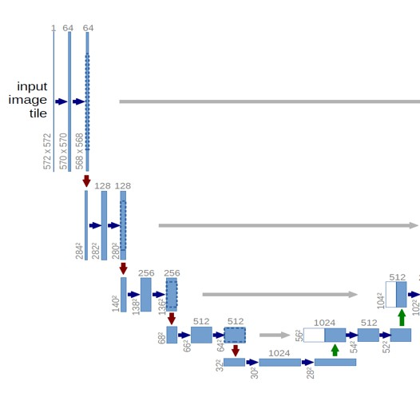
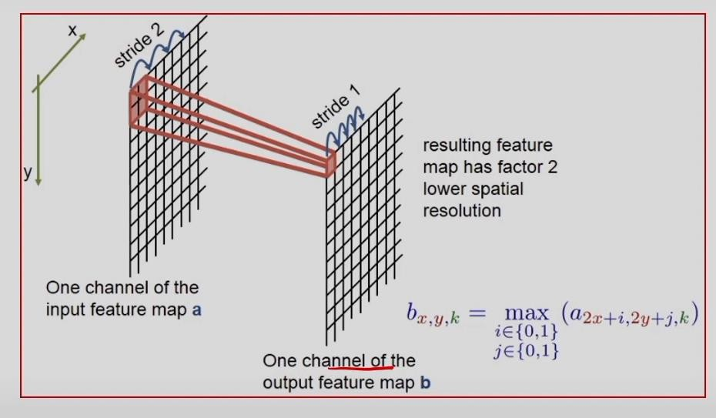
U-Net Architecture
Conv 3 x 3, ReLU
Max pool 2 x 2,
stride 2

Slide 13
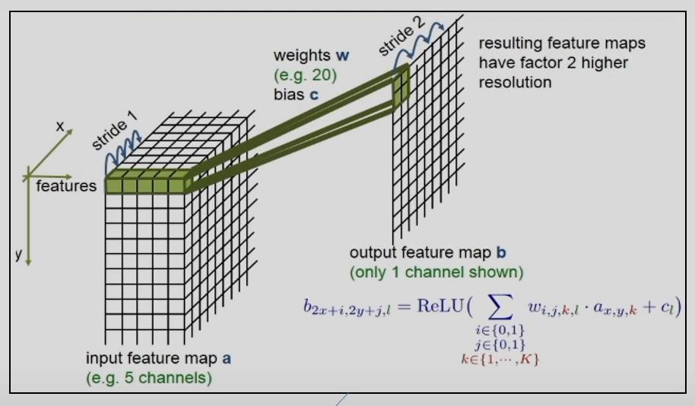
U-Net Architecture
Conv 3 x 3, ReLU
Max pool 2 x 2,
stride 2
Up-conv 2 x 2,
stride 2

Slide 14
U-Net Architecture
Concatenate with high- resolution feature maps from the Contraction Phase
2 classes (background and foreground)
Ronneberger et al. (2015) U-Net Architecture

Slide 15
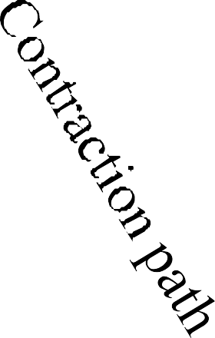
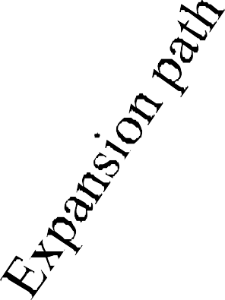
U-Net Architecture
2 classes (background and foreground)
Create high- resolution segmentation map
Ronneberger et al. (2015) U-Net Architecture

Slide 16
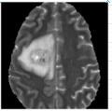
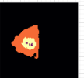
IMAGE SEGMENTATION
Convolutional Unit
Down-sampling Unit
Convolutional Unit
Down-sampling Unit
Convolutional Unit
Convolutional Unit
Up-sampling Unit
Convolutional Unit
Up-sampling
Unit

Slide 17
U-Net Summary
Contraction Phase
Reduce spatial dimension, but increases the “what.”
Expansion Phase
Recovers object details and the dimensions, which is the “where.”
Concatenating feature maps from the Contraction phase helps the Expansion phase with recovering the “where” information.

Slide 18
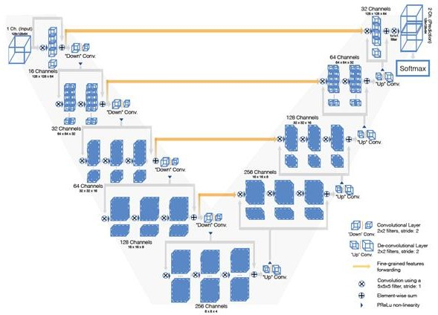
V-Net Architecture
Fausto et al. (2015) V-Net Architecture

